Slide 1
CSS Architecture For Large-scale Angular Apps
by Alex Castillo
AngularJS Meetup February 2015

Slide 2
About DOOR3
DOOR3 is a digital communications firm that designs and builds interactive enterprise applications for web, social and mobile media.

Slide 3
About DOOR3:
Services
Cross-platform Digital Strategy
User Experience Design
Web & Mobile Application Services
Web & Mobile Maintenance & Support

Slide 4
About myself
Associate Director of Technology at DOOR3
Specialize in Enterprise Single-page Apps
Focus on Cross-platform and Responsive
Passion for UX & UI
Using AngularJS since v1.0.0rc1
Creator AngularCSS

Slide 5
CSS Architecture
For Large-scale AngularJS Apps

Slide 6
The Early Days of the Web
The presentation layer has evolved
Inline styles
Multiple master templates
Stylesheets at page-by-page basis

Slide 7
Modern presentation layer architecture
Single-page Apps
Responsive Web Design (breakpoints)
Cross-platform
Modern Frameworks and Libraries
AngularJS, Bootstrap, Angular Material Design

Slide 8
Modern presentation layer architecture
CSS Scope Issues
Lack of Best Practices
Performance
The whole presentation layer of the app is being front-loaded (generally)

Slide 9
Performance

Slide 10
Performance:
Loading all the CSS
What’s the problem with loading all the CSS?
Large-scale apps contain a lot of CSS
Downloading CSS for breakpoints that won’t be part of the experience.
E.g.: tablet CSS on a smartphone device

Slide 11
What is a Breakpoint?
A breakpoints is a set of rules based on conditions such as screen resolution, that can be targeted in order to adapt content rendering to its environment.
For example: (min-width: 768px)

Slide 12
Performance:
Loading all the CSS
Single stylesheet containing all styles and media queries for each breakpoint.
Number of lines: 4750
Total File size: 90.24 kb

Slide 13
Performance:
Loading all the CSS
Multiple stylesheets containing all styles for each breakpoint.

Slide 14
CSS and Scopes

Slide 15
Third-party
Global
View-specific
Component-specific
Breakpoint-specific

Slide 16
CSS and Scopes
Third-party stylesheets
Internal stylesheets
Global
View-specific
Component-specific
Breakpoint-specific

Slide 17
CSS and Scopes: Third-party
Utils
reset.css, normalize.css, etc
Libraries
Bootstrap, Material Design, etc
Widgets
Chosen, jQuery plugins, etc
External Fonts:
Google Fonts, Typekit, etc

Slide 18
CSS and Scopes: Global
Custom Fonts
Icons
Icomoon, Font Awesome, etc
Layouts
App-wide styles
Style guide

Slide 19
CSS and Scopes: View-specific
Target DOM elements of a single view or state.
ngRoute
UI Router
Angular Route Segment
Other routing modules

Slide 20
CSS and Scopes: Component-specific
Target DOM elements of Directives.

Slide 21
CSS and Scopes: Breakpoint-specific
Target DOM elements of:
Views (routes)
Components (directives)
And separated by breakpoint.

Slide 22
Best Practices

Slide 23
Best Practices
Object Oriented CSS
Leverage Responsive Utilities
Bootstrap, Angular Material Design
Separate Stylesheets by Scope
AngularCSS

Slide 24
Best Practices: Object Oriented CSS
A CSS “object” is a repeating visual pattern, that can be abstracted into an independent snippet of HTML, CSS, and possibly JavaScript.
That object can then be reused throughout a site.

Slide 25
Best Practices: Object Oriented CSS
Separate structure and presentation
Repeating visual features
Using classes to name your objects and their components
Referencing these classes in your stylesheets

Slide 26
Best Practices: Object Oriented CSS
Separate container and content
Rarely use location-dependent styles
All unclassed elements will look the same
All mixins will look the same
No need to override unclassed elements based on location

Slide 27
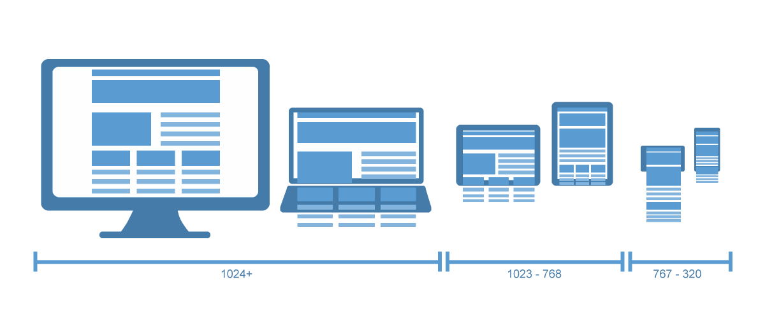
Best Practices: Leverage Responsive Utilities

Slide 28
Best Practices: Leverage Responsive Utilities
Bootstrap
visible
visible-[breakpoint]
visible-[breakpoint]-[display]
hidden
hidden-[breakpoint]
display: block;
display: block; on [breakpoint]
display: [block, inline, inline-block]; on [breakpoint]
display: none;
display: none; on [breakpoint]

Slide 29
Best Practices: Leverage Responsive Utilities
Angular Material Design
hide
hide-[breakpoint]
hide-gt-[breakpoint]
show
show-[breakpoint]
show-gt-[breakpoint]
display: none;
display: none; on [breakpoint]
display: none; on breakpoints greater than [breakpoint]
negates hide
negates hide on [breakpoint]
negates hide on breakpoints greater than [breakpoint]

Slide 30
Best Practices: Leverage Responsive Utilities
Angular Material Design
layout
layout-[breakpoint]
layout-gt-[breakpoint]
sets the default layout on all breakpoints
sets the layout on [breakpoint]
sets the layout on breakpoints greater than [breakpoint]

Slide 31
Best Practices: Leverage Responsive Utilities
Angular Material Design
layout-align
layout-align-[breakpoint]
layout-align-gt-[breakpoint]
sets child alignment
sets child alignment on [breakpoint]
sets child alignment on breakpoints greater
than [breakpoint]

Slide 32
Best Practices: Leverage Responsive Utilities
Angular Material Design
flex-order
flex-order-[breakpoint]
flex-order-gt-[breakpoint]
sets element order
sets element order on [breakpoint]
sets element order on breakpoints greater
than [breakpoint]

Slide 33
Best Practices: Separate Stylesheets by Scope
Third-party
Global
View-specific
Component-specific
Breakpoint-specific

Slide 34
Best Practices: Separate Stylesheets by Scope
/views
/checkout
/checkout.html
/checkout.ctrl.js
/checkout.css (view-specific css)
/checkout.sm.css (breakpoint-specific css)
/checkout.md.css (breakpoint-specific css)
/checkout.lg.css (breakpoint-specific css)

Slide 35
Best Practices: Separate Stylesheets by Scope
/components
/search
/search.html
/search.ctrl.js
/search.css (component-specific css)
/search.sm.css (breakpoint-specific css)
/search.md.css (breakpoint-specific css)
/search.lg.css (breakpoint-specific css)

Slide 36
CSS in AngularJS

Slide 37
Introducing AngularCSS
AngularCSS is a JavaScript module for Angular that optimizes the presentation layer of your single-page apps.

Slide 38
AngularCSS Features
API for CSS Architecture
Directives, ngRoute, UI Router, via Service
Injects stylesheets only as needed
Stylesheets are lazy-loaded
Responsive Utilities
Via Smart Media Queries
Cache Features

Slide 39
AngularCSS Benefits
Optimization
Page and Web Component Encapsulation
Provides context
Makes debugging CSS easier

Slide 40
API for CSS Architecture
AngularCSS encourages an organized and scalable CSS architecture by separating stylesheets by sections, pages, components and breakpoints.

Slide 41
Demo
AngularCSS

Slide 42
Getting Started with AngularCSS
Reference the JavaScript library in your index.html after angular.js
Add “door3.css” as a dependency for your app.

Slide 43
Encapsulation
In Angular we can attach templates (structure) and controllers (behavior) to pages and components.

Slide 44
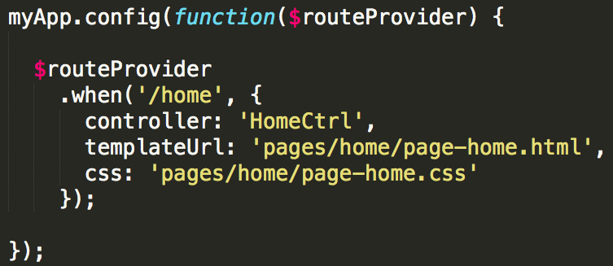
Encapsulation
With AngularCSS we can now attach CSS (presentation) to pages.

Slide 45
Encapsulation
With AngularCSS we can now attach CSS (presentation) to components.

Slide 46
Smart Media Queries
It evaluates the media query and checks if the breakpoint matches before adding the stylesheet to the page.
This can significantly optimize the load time of your apps.

Slide 47
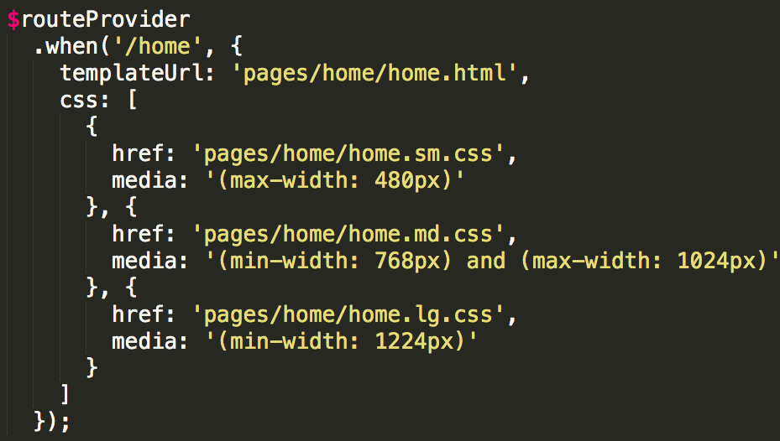
Multiple breakpoints via media attribute.

Slide 48
Multiple breakpoints via breakpoints defaults.

Slide 49
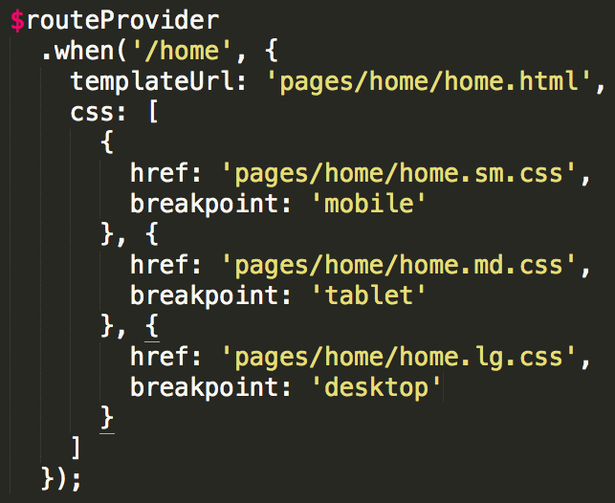
Multiple breakpoints via breakpoints defaults.

Slide 50
Demo
Smart Media Queries

Slide 51
CSS and Cache
It is possible to preload stylesheets before the route or directive are active. Then they are loaded from the browser’s cache making it way faster to resolve. Cache busting option is also available.

Slide 52
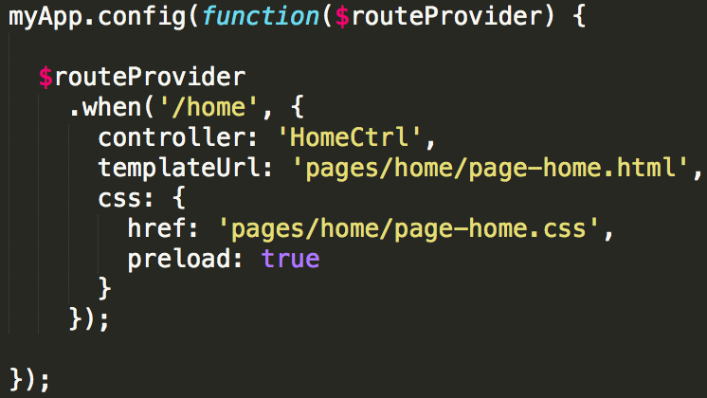
Preloading at the stylesheet level.

Slide 53
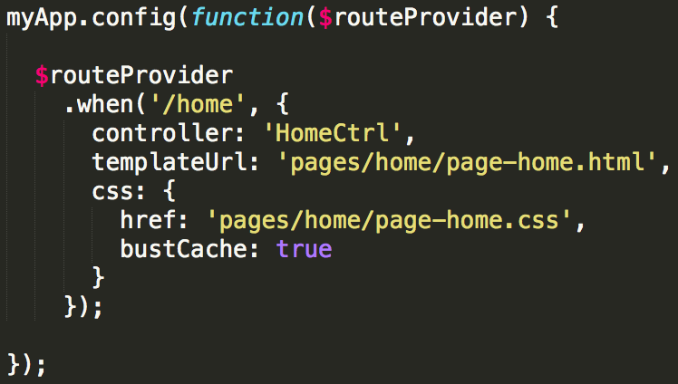
Cache busting at the stylesheet level.

Slide 54
Demo
Cache Features

Slide 55
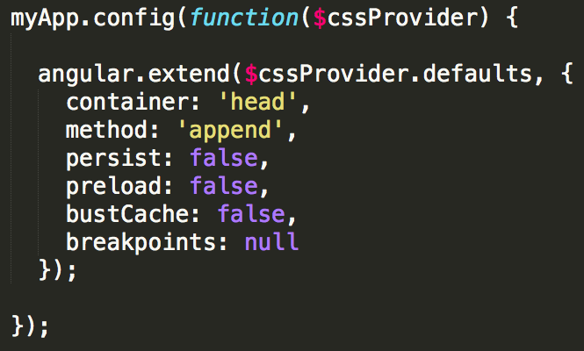
Configuring defaults

Slide 56
AngularCSS and Sass
Using Sass with AngularCSS is easy. By simply mirroring the structure of your app’s components within your Sass Directory, you can output CSS to your apps component’s directories.

Slide 57
Sass Directory Structure
Sample directory structure for Sass & AngularCSS.
/app
/assets
/sass
/components
...
/pages
...
app.scss
/app
/components
...
/pages
...
app.css
app.js

Slide 58
config.rb setup
Note that our CSS root is the application root. This means we can mirror any application directory structure within our Sass directory.

Slide 59
Sass and its CSS Output
Sass
/app
/assets
/sass
/components
/login
login.scss
/pages
/home
home.scss
CSS Output
/app
/components
/login
login.css
login.dir.js
login.html
/pages
/home
home.css
home.ctrl.js
home.html

Slide 60
How AngularCSS Works
Injecting a compiled repeatable <link> element to the DOM
Via Angular’s $compile service
jqLite DOM append/prepend

Slide 61
How AngularCSS Works
Adding and removing stylesheet objects from scope
By listening routes events
By extending and decorating custom directives

Slide 62
How AngularCSS Works:
Routes
The service listens for route and states event changes, then it adds the stylesheets defined on the current route and removes stylesheets from the previous route via its service: $css

Slide 63
How AngularCSS Works:
Directives
Decorate custom directives in order to access the DDO and scope
Extended the Angular directive API to support events
Use DDO containing the css property to add
Use the scope to remove stylesheets on scope $destroy event

Slide 64
How to Test
Using to compare the href property value against href attribute value.

Slide 65
What’s next?
CSS in Angular 2.0

Slide 66
CSS in Angular 2.0 Routing
The 1.4 release is targeting a new router for Angular 1 and Angular 2

Slide 67
CSS in Angular 2.0 Directives
3 Types of Directives:
Component
Template
Decorator
No template support
Hence no AngularCSS support

Slide 68
CSS in Angular 2.0
Directives
Directives based on Web Components backed by Shadow DOM.
Addresses the DOM tree encapsulation problem
Isolated CSS Scope

Slide 69
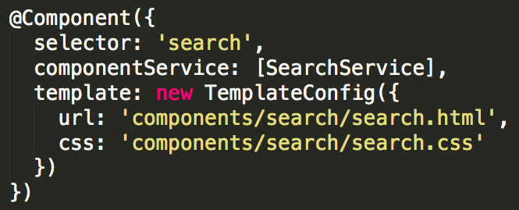
CSS in Angular 2.0:
AngularCSS API Draft

Slide 70
Resources
AngularCSS Demo
http://door3.github.io/angular-css
AngularCSS Article
http://door3.com/insights/introducing-angularcss-css-demand-angularjs
Download this Presentation
tinyurl.com/angular-css
OOCSS
https://github.com/stubbornella/oocss/wiki
Intro to Shadow DOM
http://code.tutsplus.com/tutorials/intro-to-shadow-dom--net-34966
Web Components Explained
https://dvcs.w3.org/hg/webcomponents/raw-file/57f8cfc4a7dc/explainer/index.html

Slide 71
Get AngularCSS
GitHub
https://github.com/door3/angular-css
Bower
$ bower install angular-css
CDNJS
https://cdnjs.com/libraries/angular-css
Angular Modules
http://ngmodules.org/modules/angular-css
NPM
https://www.npmjs.com/package/angular-css

Slide 72
Thank you

